Slide 1
Journalism Funding Through Partnerships
July 20, 2022
Kate Burnie, North Carolina Public Radio Amy Davis, WABE
Kathy Merritt, Corporation for Public Broadcasting Sarah Morris, KCUR
Meegan White, The Grant Center for Public Media

Slide 2
A partnership between:

Slide 3
What We Offer:
•Searchable database of 500+ grants tailored specifically to public media
•Federal and foundation funding
•Timely alerts about new and upcoming grant opportunities
•Members only Roundup newsletter
•Custom prospect research
•One-on-one consultations
•Quarterly check-ins on Zoom
•Support for development professionals new to public media
•And more!

Slide 4
Connecting Stations with Funding Opportunities for Journalism
Facebook Journalism Project (now Meta)
Google News Initiative
Pulitzer Center Environmental Journalism grants
Prospect research for funding a desk (health, education, etc.)
Strategy consultations for approach and sustainability

Slide 5
Join the Grant Center Today
Contact Meegan White (mwhite@apts.org) to set up an online tour for your team
Annual fee: $2,900
www.apts.org/grantcenter/signup

Slide 6
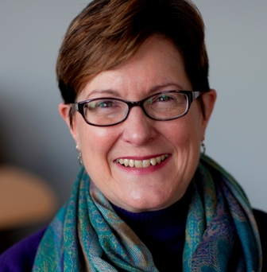
Kathy Merritt
Senior VP, Radio Journalism and CSG Services
Corporation for Public Broadcasting

Slide 7
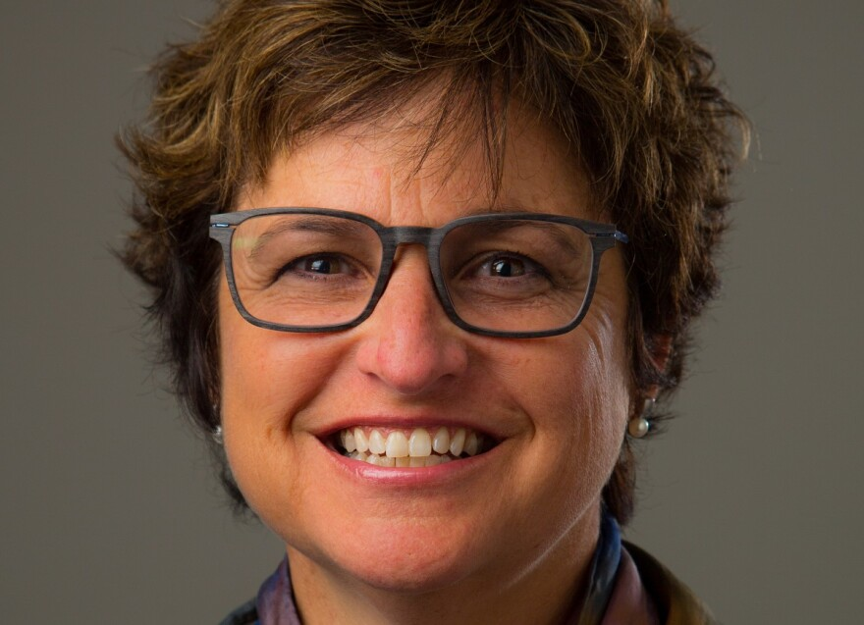
Sarah Morris
General Manager
KCUR (Kansas City)

Slide 8
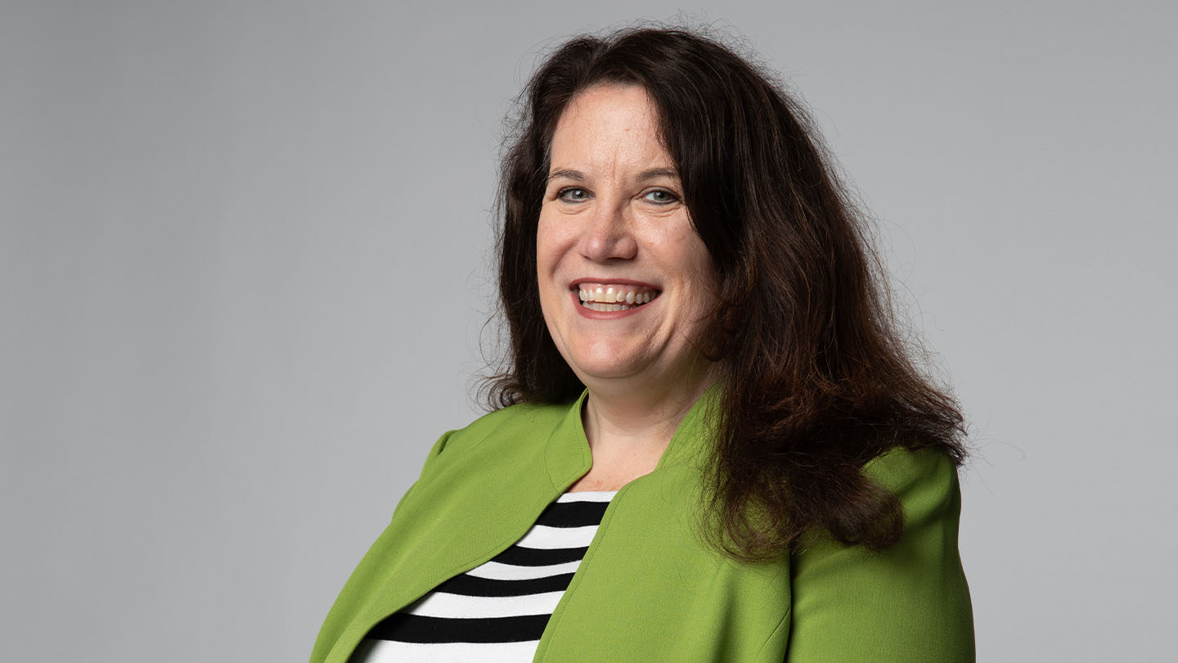
Amy Davis
Director of Foundation Relations & Grants
WABE (Atlanta)

Slide 9
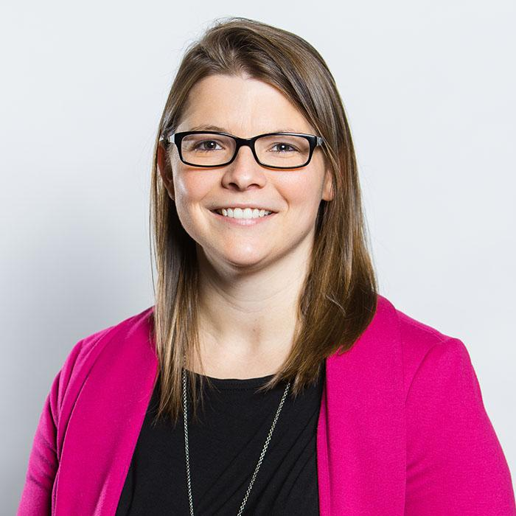
Kate Burnie
Grants and Major Gifts Officer
North Carolina Public Radio

Slide 10
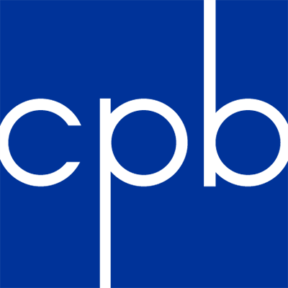
Journalism grants

Slide 11
FY 2022
$465,000,000
$27,900,000
≥6%
≤5%
$23,250,000
Notes:
The Public Broadcasting Act outlines how CPB distributes its funds and how the appropriation from Congress is allocated. This chart shows that allocation. This year, CPB’s federal appropriation is $445 million. No more than 5% goes to CPB operations; no less than 6% goes to system support to pay for things such as music rights for stations. Of the remaining 89%, 75% goes to television for CSG and programming and 25% goes to radio for CSG and programming. The area circled in red shows the funding available for Radio CSGs. As you know, there is a restricted portion and an unrestricted portion of the funds. Unrestricted funds can be used for general operations of the station, as defined in the Radio CSG general provisions, and the unrestricted portion must be used for production or acquisition of national programming. This year, the Radio CSG program will distribute about $93 million in funds.

Slide 12
FY 2022
$465,000,000
$27,900,000
≥6%
≤5%
$23,250,000
Stations & Programming 89%
75%
25%
Notes:
The Public Broadcasting Act outlines how CPB distributes its funds and how the appropriation from Congress is allocated. This chart shows that allocation. This year, CPB’s federal appropriation is $445 million. No more than 5% goes to CPB operations; no less than 6% goes to system support to pay for things such as music rights for stations. Of the remaining 89%, 75% goes to television for CSG and programming and 25% goes to radio for CSG and programming. The area circled in red shows the funding available for Radio CSGs. As you know, there is a restricted portion and an unrestricted portion of the funds. Unrestricted funds can be used for general operations of the station, as defined in the Radio CSG general provisions, and the unrestricted portion must be used for production or acquisition of national programming. This year, the Radio CSG program will distribute about $93 million in funds.

Slide 13
FY 2022
$465,000,000
$27,900,000
≥6%
≤5%
$23,250,000
Stations & Programming 89%
75%
25%
TV
Community Service Grants $232,790,625
Radio
Community Service Grants $96,220,125
75%
93%
Notes:
The Public Broadcasting Act outlines how CPB distributes its funds and how the appropriation from Congress is allocated. This chart shows that allocation. This year, CPB’s federal appropriation is $445 million. No more than 5% goes to CPB operations; no less than 6% goes to system support to pay for things such as music rights for stations. Of the remaining 89%, 75% goes to television for CSG and programming and 25% goes to radio for CSG and programming. The area circled in red shows the funding available for Radio CSGs. As you know, there is a restricted portion and an unrestricted portion of the funds. Unrestricted funds can be used for general operations of the station, as defined in the Radio CSG general provisions, and the unrestricted portion must be used for production or acquisition of national programming. This year, the Radio CSG program will distribute about $93 million in funds.

Slide 14
FY 2022
$465,000,000
$27,900,000
≥6%
≤5%
$23,250,000
Stations & Programming 89%
75%
25%
TV
Community Service Grants $232,790,625
Radio
Community Service Grants $96,220,125
75%
93%
TV Programming $77,596,875
Radio Programming $7,242,375
25%
7%
Notes:
The Public Broadcasting Act outlines how CPB distributes its funds and how the appropriation from Congress is allocated. This chart shows that allocation. This year, CPB’s federal appropriation is $445 million. No more than 5% goes to CPB operations; no less than 6% goes to system support to pay for things such as music rights for stations. Of the remaining 89%, 75% goes to television for CSG and programming and 25% goes to radio for CSG and programming. The area circled in red shows the funding available for Radio CSGs. As you know, there is a restricted portion and an unrestricted portion of the funds. Unrestricted funds can be used for general operations of the station, as defined in the Radio CSG general provisions, and the unrestricted portion must be used for production or acquisition of national programming. This year, the Radio CSG program will distribute about $93 million in funds.

Slide 15
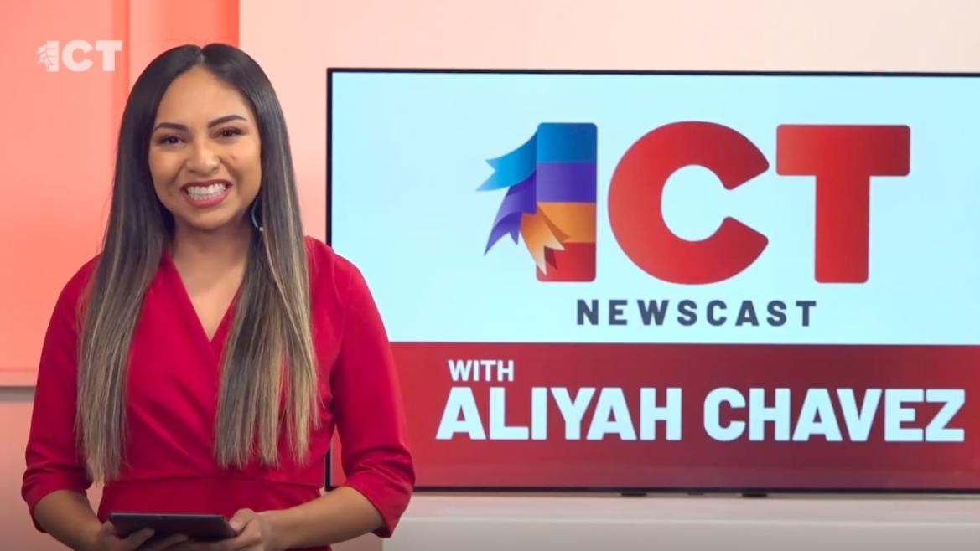
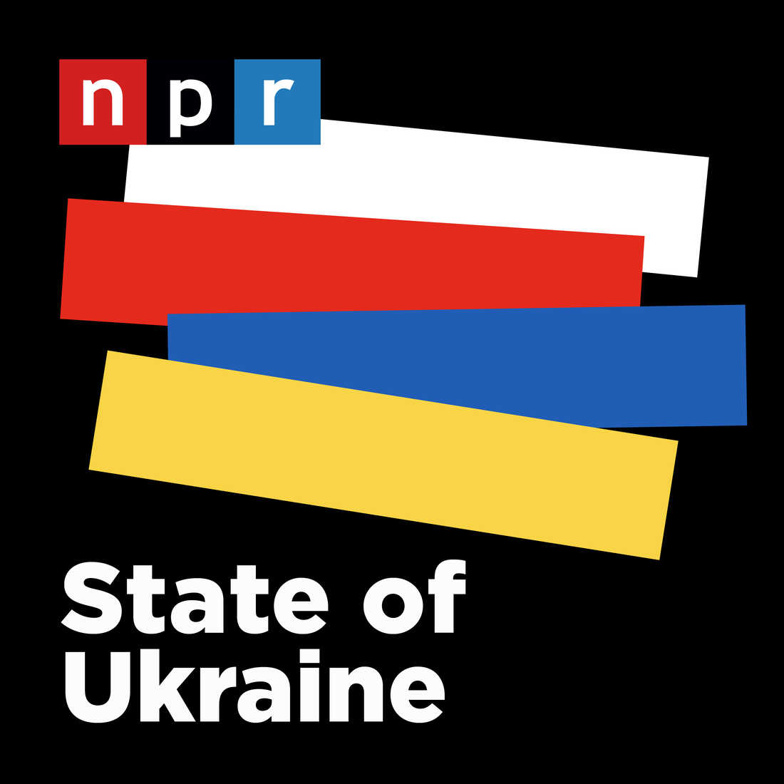

Slide 16
Journalism collaboration
CPB has invested more than $42 million since 2010
41 collaborations involving 150 stations
Gulf States Newsroom
New England News Collaborative
Ohio Valley ReSource
Harvest Public Media
Texas News Collaborative

Slide 17
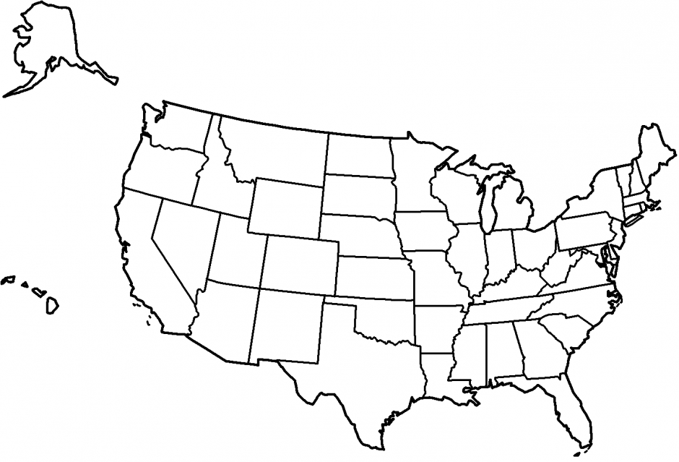
Kansas News Service
Indiana Newsroom
Mountain West
Harvest
Illinois Newsroom
Detroit Newsroom
Innovation Trail
Earthfix
Great Lakes
Diverse Newsrooms
Big Footprint
BF
DN
AP
AH
DN
BF
AP
New England News Collaborative
BF
SE
California Dream
SE
SE
Side Effects
AP
DN
DN
SE
SE
AH
Ohio Valley ReSource
AP
AH
Fronteras
AP
Kentucky Collaboration
AH
Healthy State
Alaska Energy Desk
AH
Sustainability
Accountability Project
AH
Texas Collaborative
American Homefront
Natural State News
Gulf States Newsroom
Notes:
These collaborations foster a vibrant multimedia network of high-quality local and regional journalism with national reach.
We’ve also been assessing the role of editors in public media – seeking out opinions of key leaders and gathering information on the types of skills required for effective newsroom leaders. We’ve discovered how challenging it is for stations and national productions to find editors who can meet the demands of leading newsrooms and collaborations today. There’s no pipeline of editors in public media. Good reporters are elevated to leadership positions with little or no training in how to be successful.

Slide 19
Kathy Merritt svp, Journalism, Radio & csg services kmerritt@cpb.org Joy Lin VP, Journalism jlin@cpb.org

Slide 20
Partnerships

Slide 21
Sustainability

Slide 22
The Value Proposition
for Funders

Slide 23
Questions?

Slide 24
Speaker Information
Kate Burnie Grants and Major Gifts Officer, North Carolina Public Radio kburnie@email.unc.edu
Amy Davis, Director of Foundation Relations & Grants, WABE adavis@wabe.org
Kathy Merritt Senior VP, Radio Journalism and CSG Services, CPB kmerritt@cpb.org
Sarah Morris General Manager KCUR sarahm@kcur.org
Meegan White Director Grant Center for Public Media mwhite@apts.org

